Slide 1
Lecture 2
Imran

Slide 2
Ann is one of the curator of a museum. She is 33 years old. She got 8 colleagues who are older than her but not more than age 45. Her responsibility is to input the museum collection in a document. Museum is going to create a software for Ann and her colleagues. Every time museum receive any item , then Ann or her colleagues are going to input them ins a system. They have good command in English language. After 7 p.m they are not going to input any data in the system. [Create the user profile]

Slide 3
Definition : Requirement
(1) A condition or capability needed by a user to solve a problem or achieve an objective.
(2) A condition or capability that must be met or possessed by a system or system component to satisfy a contract, standard, specification, or other formally imposed documents.
(3) A documented representation of a condition or capability as in (1) or (2).

Slide 4
Requirement Eng.
Definition : Requirements Engineering
(1) Requirements engineering is a systematic and disciplined approach to the specification and management of requirements with the following goals:
(1.1) Knowing the relevant requirements, achieving a consensus among the stakeholders about these requirements, documenting them according to given standards, and managing them systematically
(1.2) Understanding and documenting the stakeholders’ desires and
needs, they specifying and managing requirements to minimize the
risk of delivering a system that does not meet the stakeholders’
desires and needs

Slide 5
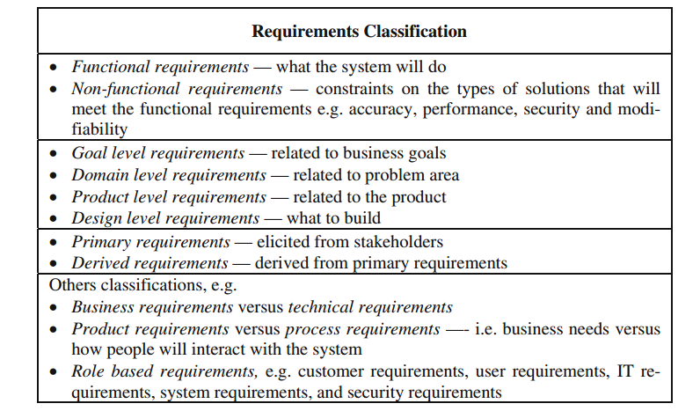

Slide 6
A stakeholder of a system is a person or an organization that has an (direct or indirect) influence on the requirements of the system.

Slide 7
The Role of Stakeholders in Requirements Engineering
Those participants in the development process together with any other individuals, groups or organizations whose actions can influence or be influenced by the development and use of the system whether directly or indirectly
Typical stakeholders are product managers, various types of users and administrators from the client side, and software team members from the software development side.

Slide 8
Four core activities
Elicitation: During requirements elicitation, different techniques are used to obtain requirements from stakeholders and other sources and
to refine the requirements in greater detail.
Documentation: During documentation, the elicited requirements are
described adequately. Different techniques are used to document the
requirements by using natural language or conceptual models
Validation and negotiation: In order to guarantee that the predefined
quality criteria are met, documented requirements must be validated and
negotiated early on
Management: Requirements management is orthogonal to all other activities and comprises any measures that are necessary to structure
requirements, to prepare them so that they can be used by different roles, to maintain consistency after changes, and to ensure their implementation

Slide 9
Techniques and Approaches of Req.
Interviews
Questionnaire
Task Analysis
Domain Analysis
Introspection
Repertory Grids
Card Sorting
Laddering
Group work
Brainstorming
JAD

Slide 10
Ethnography
Observation
Protocol Analysis
Apprenticing
Prototyping
Scenarios

